Slide 1

“GROWTHIFY” Business Model Analysis
TERNA ENGINEERING COLLEGE
DEPARTMENT OF COPUTER ENGINEERING
BE/Sem VII
C60 Neha Kajrolkar
C56 Shrawani Mahajan
C57 Ashish Khandare
C68 Rutuja Kamble
Under the guidance of
Prof. S.B. Bokefode
Academic Year
2023-24

Slide 2
Content
Introduction
Abstract
Literature review
Problem Statement
Objective of Project
Scope of Project
Proposed System/ Architecture Diagram
H/W and S/W requirements
Expected Outcome
References

Slide 3
Introduction
Our system is an advanced business model analysis platform tailored to help businesses optimize their operations and drive growth. By allowing users to input data across various domains such as sales, marketing, finance, and more, the system performs a thorough analysis to uncover critical patterns, trends, and opportunities. The platform doesn't just present the data; it translates this analysis into practical insights and actionable tips. These recommendations are designed to help businesses refine their strategies, identify growth opportunities, and make informed decisions to achieve sustainable success.

Slide 4
Abstract
Our website specializes in business analysis and consulting services, utilizing advanced AI and machine learning techniques to deliver sophisticated data visualizations. Our approach transforms complex datasets into clear, actionable insights, enabling businesses to optimize operations, enhance customer experiences, and achieve their strategic objectives. By integrating state-of-the-art technology with deep industry expertise, we provide our clients with the tools they need to navigate challenges and seize opportunities in a dynamic marketplace.

Slide 5
Literature survey
AUTHOR NAME | TITLE | KEY FINDINGS | LIMITATIONS
J. Y. Wu and L. T. Chen | Odoo ERP with Business Intelligence Tool for a Small-Medium Enterprise: A Scenario Case Study | Created management dashboards and reports for real-time information. | Lack of Comparative Analysis: The research paper does not provide a comparative analysis of Odoo ERP system with other open source or commercial ERP systems, which could have offered a broader perspective on the strengths and weaknesses of different platforms. Limited Generalizability: The study is based on a scenario case study approach within a specific small-medium enterprise, limiting the generalizability of the findings to other industries or organizational contexts.

Slide 6
Literature survey
AUTHOR NAME | TITLE | KEY FINDINGS | LIMITATIONS
Agota Giedr˙e Raišien˙e and Simonas Juozapas Raišys | Business Customer Satisfaction with B2B Consulting Services: AHP-Based Criteria for a New Perspective | Proposed model enhances customer satisfaction criteria understanding and resource management. | Limitations include inconsistency in decision maker's opinions. Difficulty in assessing more than 7 items due to memory.

Slide 7
Literature survey
AUTHOR NAME | TITLE | KEY FINDINGS | LIMITATIONS
Erika Ayu Amelia | Business Model Analysis In Kartinipedia Application Using Business Model Canvas (Bmc) Approach | The Kartinipedia application's key resources include the application system and continuous idea development by human resources. Cost structure involves expenses for system development, servers, human resources, and office management. A new business model canvas is suggested after testing through the system usability scale. Revenue streams now include advertisements, AdSense, profit sharing from sales, and consulting services. Key partners are sellers, payment gateways, and social media platforms. | The research paper does not explicitly mention the specific technological platforms or programming languages used in developing the Kartinipedia application, which could provide valuable insights into the technical aspects of the project. While the research methodology includes qualitative data collection methods like interviews and observations, there is limited discussion on the potential biases or limitations associated with these approaches.

Slide 8
Literature survey
AUTHOR NAME | TITLE | KEY FINDINGS | LIMITATIONS
Rick Gilsing, Oktay Turetken, Paul Grefen, Baris Ozkan, Onat Ege Adali | Business Model Evaluation: A Systematic Review of Methods | Analyzing Data Science and Business Analytics importance in future business decisions. | Challenges of big data analytics discussed before business applications. Limitations not explicitly outlined in the provided contexts.

Slide 9
Literature survey
AUTHOR NAME | TITLE | KEY FINDINGS | LIMITATIONS
Sachin Kumar, Krishna Prasad K. and P. S. Aithal | Tech-Business Analytics – a Review-based New Model to Improve the Performances of Various Industry Sectors | Identified six groups of business model evaluation methods. Proposed a guiding structure aligning methods with innovation phases. Highlighted research gaps in sustainable business model evaluation. | Excluded non-academic sources like white papers and grey publications. Search string limitations excluded relevant articles, affecting completeness. Lack of real-world business cases affects validity of proposed structure.

Slide 10
Literature survey
AUTHOR NAME | TITLE | KEY FINDINGS | LIMITATIONS
Roshana Zameer and Kokila H.S | A study on Profitable analysis of selected companies | TCS shows increasing profitability trends over 5 years with consistent returns. WIPRO has limited growth in returns from capital employed and profits. HCL demonstrates rapid profitability ratio increase over 5 years. | Limited data collection from secondary sources like moneycontrol.com Lack of detailed analysis on specific financial metrics for companies.

Slide 11
Problem statement
Lack of Expertise: Small business owners often lack the necessary expertise to develop, analyze, and refine their business models effectively.
Accessibility Issues: There is a lack of accessible and user-friendly platforms that provide comprehensive business model analysis tools and resources.
Expensive: Implementing ERP systems costly for small-medium enterprises, requiring alternative solutions.

Slide 12
Objectives
Support Scalability: Design the platform to handle a growing number of users and expanding data sets without performance issues.
Enable Reporting and Visualization: Offer reports and visualizing data in charts and graphs to make insights easier to understand and present.
Facilitate Easy Data Input: Create user-friendly interfaces for businesses to input and manage their data effortlessly.
Support Strategic Decision-Making: Assist users in making informed strategic decisions based on their business model analysis.

Slide 13
Scope of the Project
The scope of this business model analysis system is highly promising. As businesses increasingly depend on data-driven decisions, the system can expand to include more advanced analytics, like AI-driven predictions. This would allow users to not only analyze current data but also anticipate future trends. Enhancing the system with real-time data integration and industry-specific insights could make it even more valuable. As the platform evolves, it could offer features like automated reporting, seamless integration with other business tools, and a more intuitive interface, making it an essential resource for businesses looking to grow and innovate.

Slide 14
Proposed system
The algorithm for this business model analysis system begins with data collection, where users input relevant information related to sales, marketing, finance, and other business areas. This data is then preprocessed to clean and standardize it for accurate analysis. Next, the system performs exploratory data analysis to identify patterns, trends, and correlations. Using statistical methods and machine learning techniques, the algorithm generates detailed insights and predictive models based on the analyzed data. These insights are then translated into actionable recommendations tailored to the specific needs and goals of the user. Finally, the system presents these findings through intuitive dashboards and reports, allowing users to easily interpret the results and implement the suggested strategies for business growth.

Slide 15
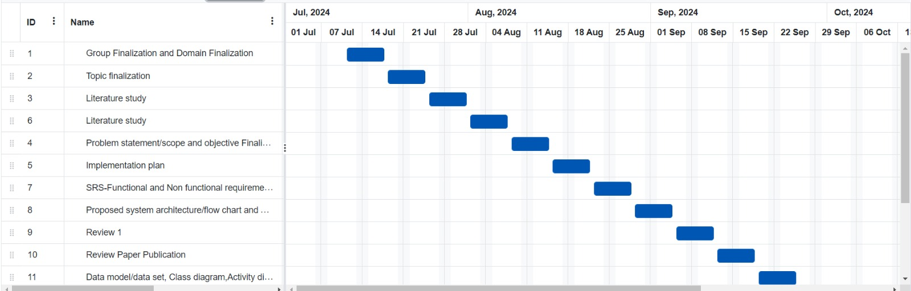
Timeline

Slide 16
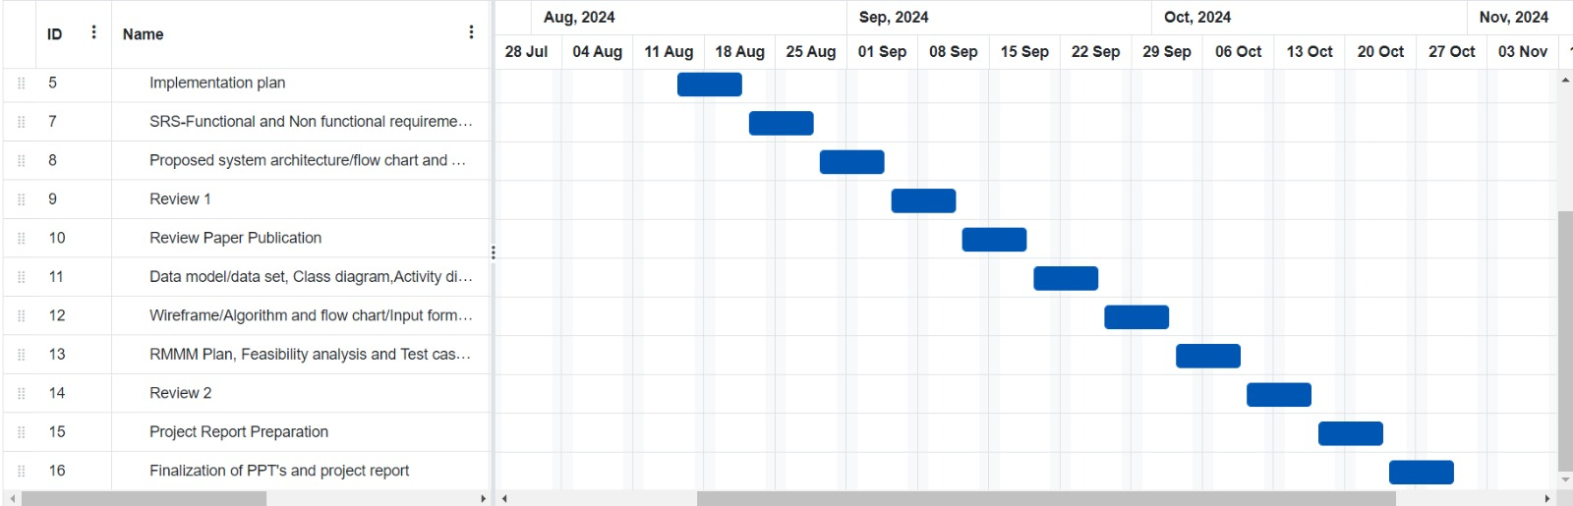

Slide 17
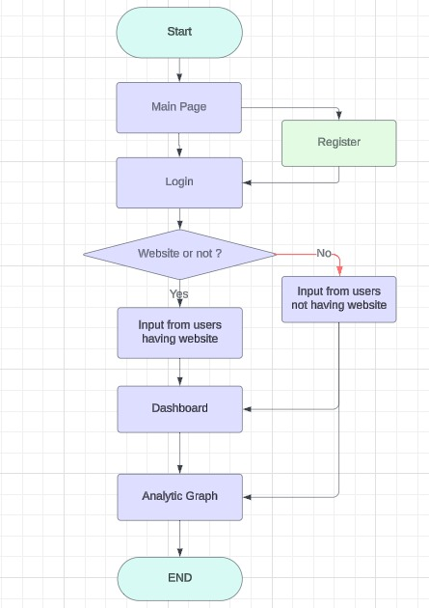
Flow chart

Slide 18
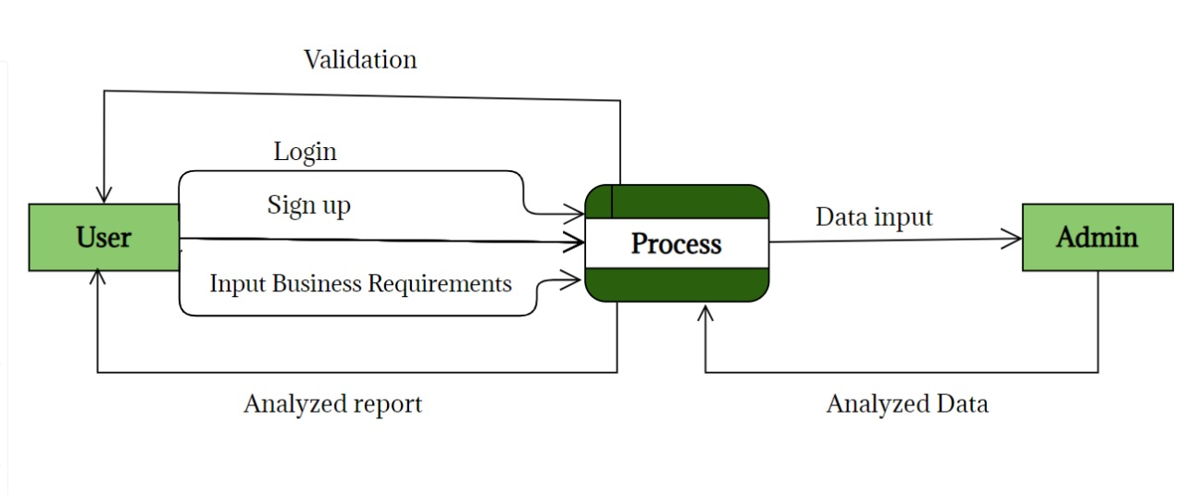
DFD LEVEL-0

Slide 19
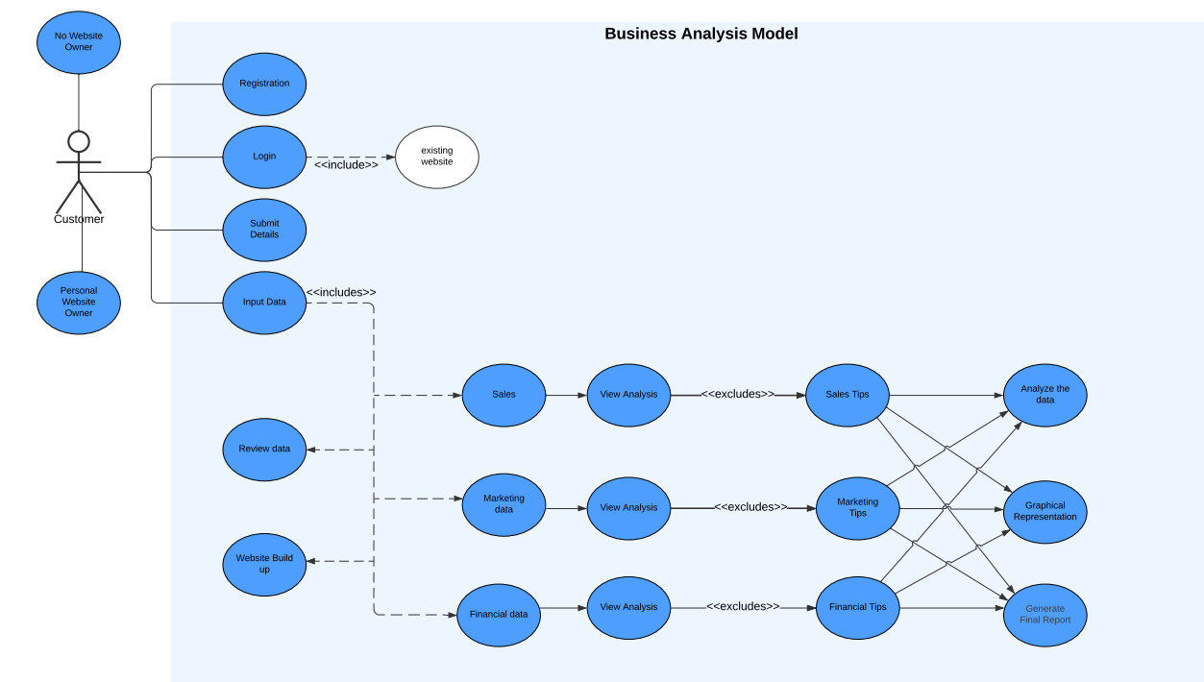
Use Case Diagram

Slide 20
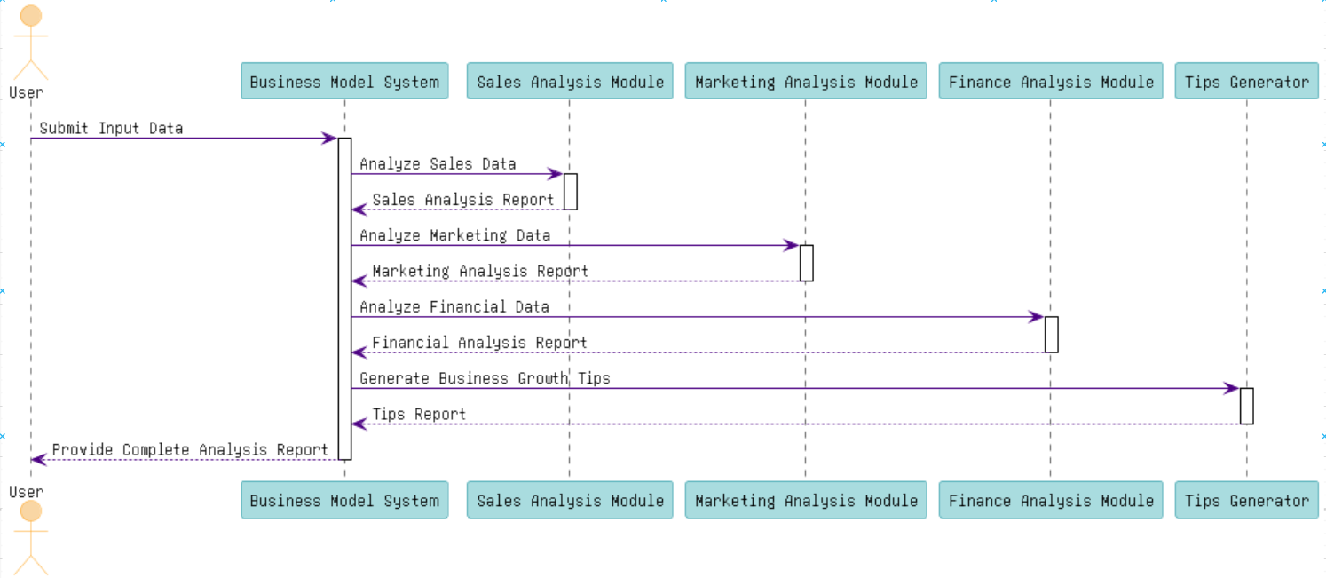
SEQUENCE DIAGRAM

Slide 21
SOFTWARE REQUIREMENTS SPECIFICATIONS (SRS)
Functional Requirements :
User Management:
Users can register, log in, and recover passwords.
Data Input and Management:
Users can input or import business data (sales, marketing, finance).
Data validation ensures accuracy.
Business Analysis:
System analyzes sales, marketing, and financial data.
Customized reports are generated based on user input.
Growth Recommendations:
System provides personalized tips and actionable insights for business growth.

Slide 22
Non-Functional Requirements :
Performance:
Reports are ready in 5 seconds or less.
Usability:
Easy-to-use design, accessible for everyone.
Security:
User data is securely protected and encrypted.
Maintainability:
Built with a modular structure, making it easy to update and maintain.

Slide 23
HARDWARE REQUIREMENTS
OS -Windows XP, Vista, 7, 8 or 10.
Memory -4GB RAM for 64 bit.
Processor –Any Pentium Version.
Hard Disk- 32 GB (64 GB recommended).

Slide 24
Expected Outcomes
Detailed Insights: Provides a comprehensive analysis of user data, revealing key patterns and trends in sales, marketing, finance, and other areas.
Actionable Recommendations: Delivers tailored tips and strategies to help businesses optimize operations and drive growth.
Predictive Analysis: Uses advanced analytics to forecast future trends and potential opportunities.
User-Friendly Reports: Presents findings through intuitive dashboards and reports for easy interpretation and decision-making.
Enhanced Decision-Making: Equips users with the information needed to make informed, data-driven decisions for business success.

Slide 25
References
J. Y. Wu and L. T. Chen. “Odoo ERP with Business Intelligence Tool for a Small-Medium Enterprise: A Scenario Case Study.”, 2020.
Agota Giedr˙e Raišien˙e and Simonas Juozapas Raišys. “Business Customer Satisfaction with B2B Consulting Services: AHP-Based Criteria for a New Perspective.”, 2022.
Erika Ayu Amelia. “Business Model Analysis In Kartinipedia Application Using Business Model Canvas (Bmc) Approach.”, 2022.
Rick Gilsing, Oktay Turetken, Paul Grefen, Baris Ozkan, Onat Ege Adali.” Business Model Evaluation: A Systematic Review of Methods”, 2022.
Sachin Kumar, Krishna Prasad K. and P. S. Aithal. “Tech-Business Analytics – a Review-based New Model to Improve the Performances of Various Industry Sectors”, 2023.
Roshana Zameer and Kokila H.S. “A study on Profitable analysis of selected companies”, 2015.

